Slide 1
Introduction to Windows Programming
Asst.Prof.Dr.Derya BİRANT
329 - Windows Programming

Slide 2
Contents
1
Windows Programming
2
Windows Forms
3
Windows Application
4
Chances of Windows Programming
5
Form Properties and Events

Slide 3
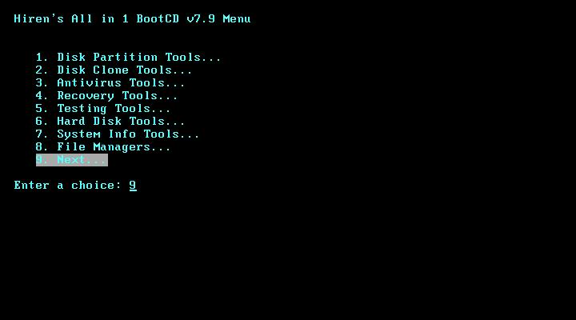
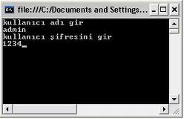
Console Application
A console application is a computer program designed to be used via a text-only computer interface, such as a text terminal, the command line interface of some operating systems (Unix, DOS, etc.).

Slide 4
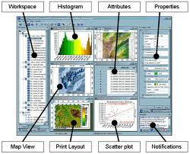
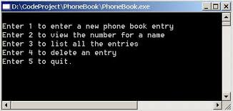
Console vs. Windows Applications
Windows Applications look different from Console Applications.

Slide 5
Graphical User Interfaces
Interface: front end of a program
  Visual image you see when you run a program
A Graphical User Interface, or GUI is a graphically based environment that you use to interact with applications.
Graphical user interface (GUI) includes:
  Menus (deferred coverage of these)
  Text in many different colors and sizes
  Other controls (pictures, buttons, etc.)

Slide 6
Graphical User Interfaces
Windows Forms - for writing GUI based applications (Windows Applications)
Graphical User Interface - to make programs easy to use
WYSIWYG (What you see is what you get)
Designing GUI-based Applications: Look & Feel
  Look => Appearance (Layout Design)
  Feel => Response (Event Handling)
User => Button Click => Event => Event Handler (a method).
GUI-based application => Event-driven programming

Slide 7
Console vs. Windows Applications
Console applications
  Each line in Main( ) executed sequentially – then the program halts
Windows applications
  Once launched, sits and waits for an event
  Sits in a process loop
Event: notification from operating system that an action, such as the user clicking the mouse or pressing a key

Slide 8

Windows Programming
Windows programming is centered around reaction to user inputs through the Windows user interface, it is said to be "event-driven ".
Programming
  to manipulate the Windows environment
  (opening and closing windows, drawing content within windows, creating menus)
  to react to a Windows user's input
  (mouse clicks, mouse movement, key presses, menu selections).

Slide 9
Windows Programming
Such programming is through the “window system application program interface”
  Graphics systems also have API’s
  Allows output control of window titles scroll bars, changing pixels, …
  Allows input of mouse movements, button presses, keyboard, …

Slide 10
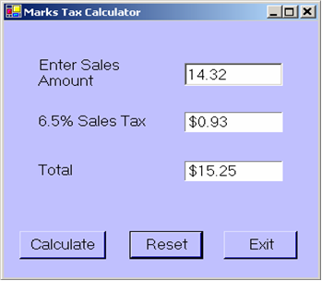
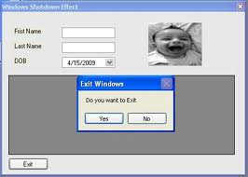
Windows Forms
A Windows Form is a container for user controls (i.e. control objects) for a given application.
The Windows Form is a vital component in the development of any Windows-based application.
Forms allow the developer to create windows and layout controls (such as buttons, labels etc) in those forms to provide the application's user interface.

Slide 11
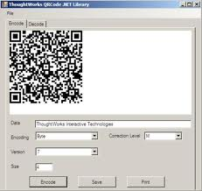
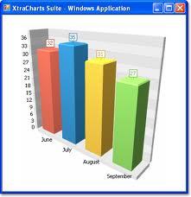
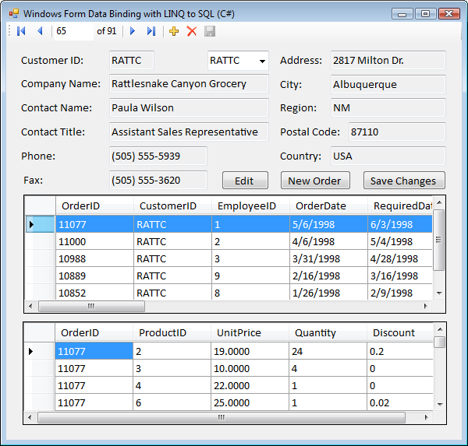
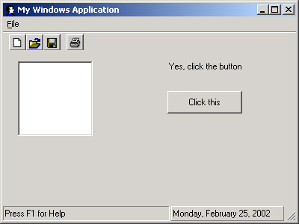
Example Windows Forms

Slide 12
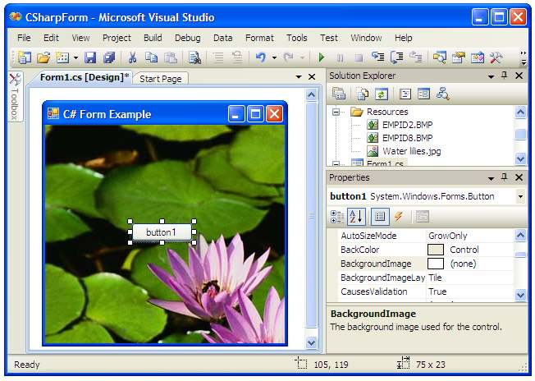
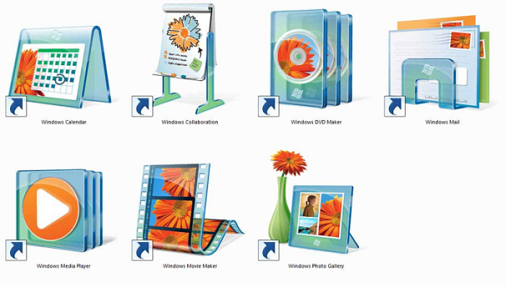
Windows Application
A Windows application is any piece of software that runs on Windows desktop.
A Windows application is a program which uses the standard Windows Graphical User Interface (GUI)
A Windows application may consist of a single form, or many forms.

Slide 13
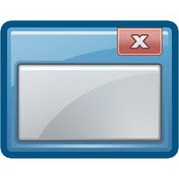
Chances of Windows Programming
Arise from user interface programming in general:
  Event driven software architectures
  Simple complexity
Real-time requirements
  Keep up with mouse tracking, Multimedia: video, animations, sound, …
Robustness
  No crashing on any input
  Helpful error messages, graceful recovery
  Allow abort and undo
Testability
  E.g, easy to test direct manipulation, same state
Rich language support (for ui, and graphics primitives)
  Special, complex, and enormous libraries
  Features like OOP, constraints, and collaborative systems
Simplicity of tools and API

Slide 14
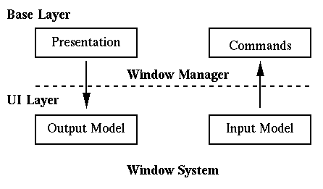
Windows Programming
Often divided into two layers:
1. Window Manager (base layer)
    Allows end users to move windows, resize them, iconify them, select them, etc
    Provides decorations on windows, such as, titles, borders, colors, icons, etc
    Often the window manager (wm) and window system (ws) are blurred into one, since many systems (suntools, macintosh, windows, next) combine them as one
    2. Window System (UI layer)
    Provides a programmer interface (API) that allows output of graphics to draw on the screen to a clipped region (window)
      this is the output model.
    Input channels from mouse/keyboard to appropriate window
      this is the input model

Slide 15
API
An Application Programming Interface, or API, is a library of methods and code that allows programmers to access the features and functionality of an application or operating system.
The Windows API allows you to write programs for Windows operating systems.

Slide 16
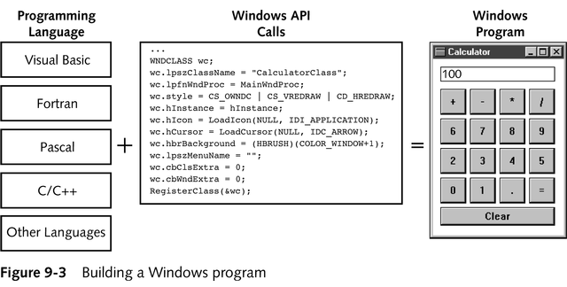
Building a Windows Program

Slide 17
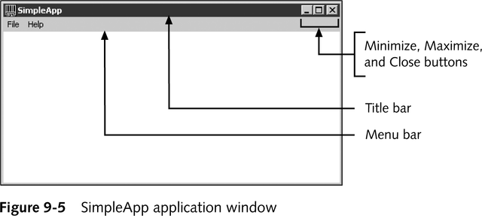
SimpleApp Application Window

Slide 18
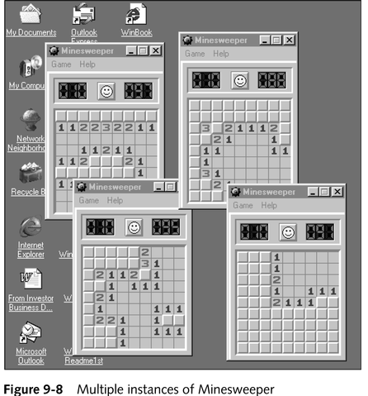
The WinMain() Function
Multiple running copies of the game Minesweeper.
Each copy of Minesweeper is an instance of the application.

Slide 19
General Properties
Become aware of some elements of good design.
Create Windows forms and be able to change form properties.
Add components (control objects) such as buttons, labels, and text boxes to a form.
Windows forms/controls offer many properties including Text, Color, Font, and Location.

Slide 20
// Windows0.cs Author: Doyle
using System.Windows.Forms; // Line 1
namespace Windows0
{
public class Form1 : Form // Line 2
{
public Form1( ) // Line 3
{
Text = "Simple Windows Application"; // Line 4
}
static void Main( )
{
Form1 winForm = new Form1( ); // Line 5
Application.Run(winForm); // Line 6
}
}
}
New namespace referenced
Base class
Constructor
Sets title bar caption
Starts process loop

Slide 21
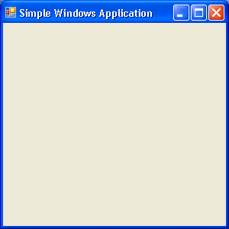
Windows Application
Output generated from Windows0 application

Slide 22

Elements of Good Design
Appearance matters
  Human-Computer Interaction (HCI) research
Design considerations
  Consistency
  Alignment
  Avoid Clutter
  Color
  Target Audience

Slide 23
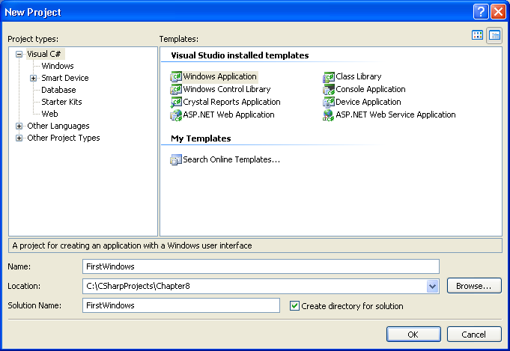
Visual Studio New Windows Application
Select File New Project
Windows Application template
Browse to location to store your work
Name

Slide 24
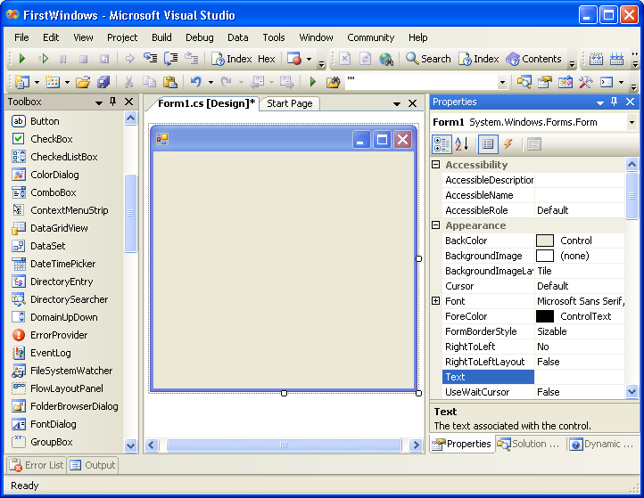
Initial Design Screen
Switch between Design and Code view using View menu
Properties Window
Design View
Toolbox

Slide 25
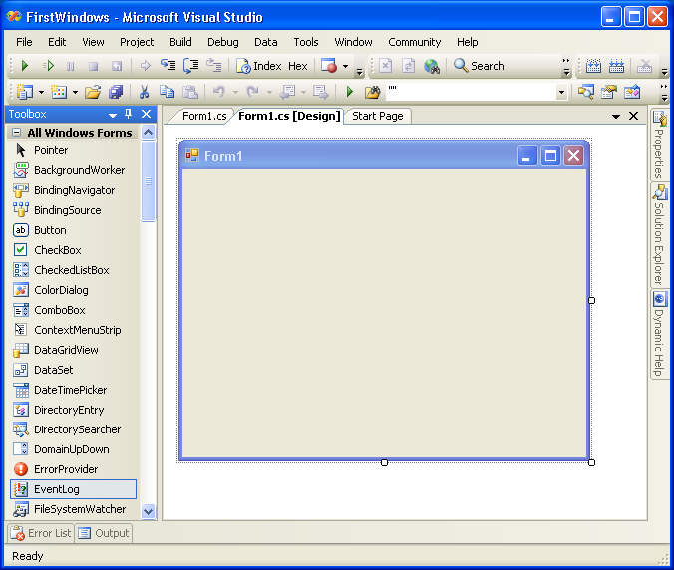
Dockable Windows
pushpin
Properties
Auto-hide
Solution Explorer
Dynamic Help

Slide 26
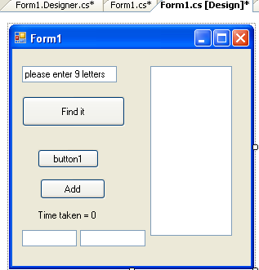
Desingning a Form
Display by clicking Form1.cs [Design] tab
Drag and Drop components (controls)
Form
Textbox
Button
Label
Listbox

Slide 27
Component Properties
Each component has large collection of properties and methods
  Select property from an alphabetized list (Properties window)
  Change property by clicking in the box and selecting or typing the new entry.

Slide 28
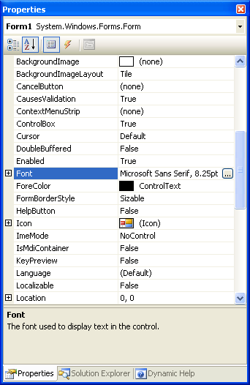
Windows Form Properties
Events
Alphabetical
Categorized
Property value
Properties
Properties window

Slide 29
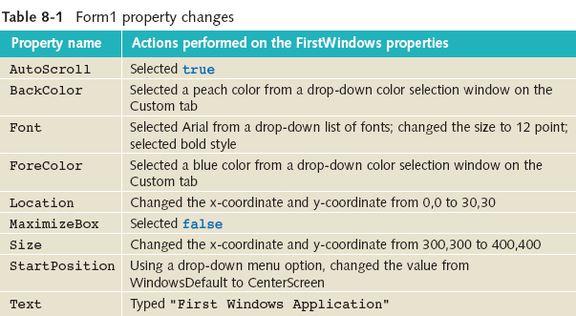
Windows Form Properties

Slide 30
Windows Form Events
Add code to respond to events, like button clicks
From the Properties window, select the lightening bolt (Events)
  Double-click on the event name to generate code

Slide 31
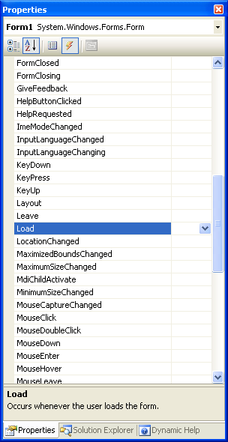
Windows Form Events
Events button selected

Slide 32

Simple Windows Application
Visual Studio IDE separates the source code into three separate files
  Form1.cs: Normally this is the only one you edit
  Form1.Designer.cs: Holds the auto-generated code
  Program.cs: Contains the Main( ) method, where execution always begins

Slide 33
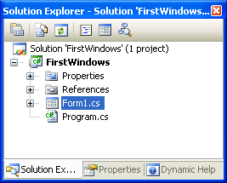
Windows Project
Expand Form1.cs node to reveal the Form1.Designer.cs file

Slide 34

Form Properties
The Properties / Events window
Properties
Each component has properties – e.g.
  Name
  Position (top and left)
  Size (height and width)
  Text
Description of property

Slide 35
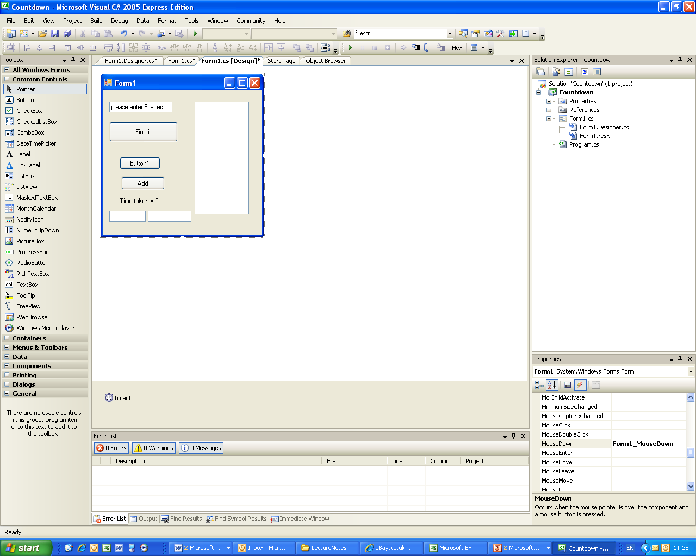
Form Events
The Properties / Events window
Events
Events – happen to controls e.g:
  Button click
  KeyPress
  MouseMove
  MouseDown
Others – Form load

Slide 36
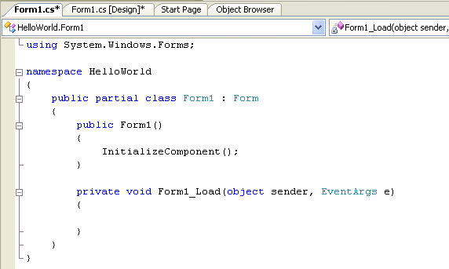
The Code Editor
The Code Editor – where you enter your code
Double-click object to enter code

Slide 37
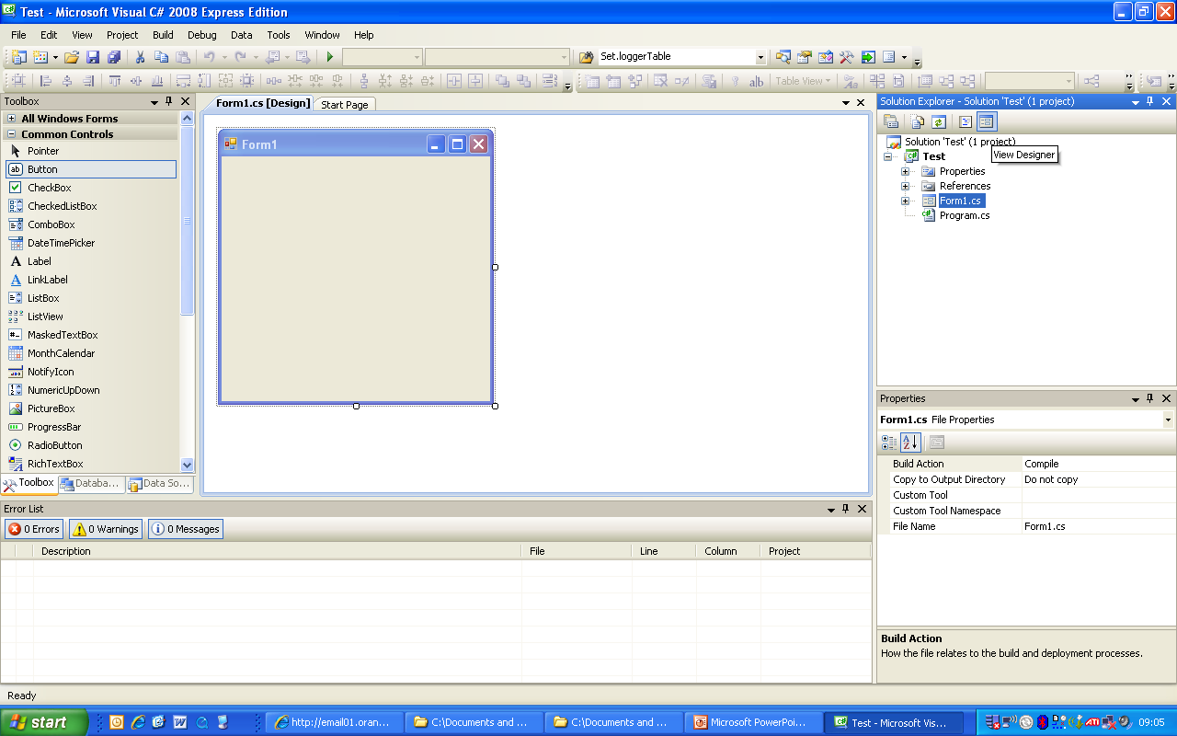
Your First C# Program - I
Start a new Project > Windows Form Application
Display the form (click form1.cs[Design] tab).
Add button (drag and drop) from Toolbox to form

Slide 38
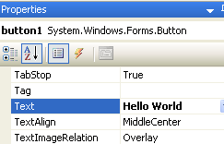
Your First C# Program - II
Change the button’s text display (a property).
Display the properties window,
Scroll to the Text property, type in ‘Hello world’

Slide 39
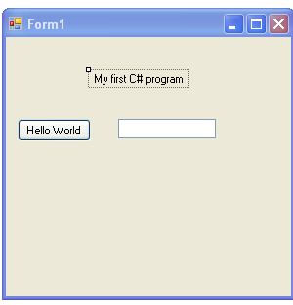
Your First C# Program - III
Place TextBox and Label to form
Change label’s caption property to ‘My First C# Program’.
Form looks like:

Slide 40
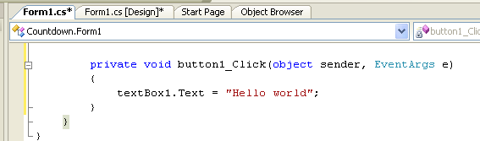
Your First C# Program - IV
Double-click button to add code for button click
Add code: textBox1.Text="Hello world";

Slide 41
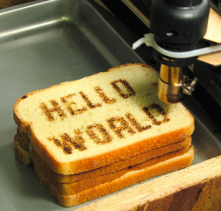
Your First C# Program - V
Run program, click button.
‘Hello World’ is displayed

Slide 42
See You Next Week!
Asst.Prof.Dr.Derya BİRANT
329 - Windows Programming

